Slide 1
Geohazard Management: Toward a National High Priority, Geotechnical Asset, and Event Initiative
John Metzger, IDS North America
Ever increasing challenges among the interface of natural terrain, people, and transportation corridors.
Evolution of instrumentation for monitoring – advances in traditional instrumentation, photogrammetry, LIDAR, SatSAR, TinSAR.
Strides in data acquisition and transmission – Drones, LIDAR/GPR combo, updates of Sat/TinSAR instruments, GNSS platforms = more data and larger datasets.
** Interest and awareness among national agency contacts, DOT professionals, academics, and colleagues – for CHANGE – a maturing of technology that is primed for ACTION – “PROACTION”.
1

Slide 2
In our community, in telephone calls, in the press, at meetings and fora like this we see a march towards data driven practice/results.
Hunger for action and solution based activities :
AFFORDABLE interventions – where data is acquired
and can be considered (“now-time”) and available
for decision making.
Demand to spell out clearly TOOLS, PRACTICE, STANDARDS –across the temporal geospatial monitoring sector – where few, if any standards exist.
Manufacturer/Vendor as a resource – aligning with client needs – cross educating ….because time is valuable…demand for solutions is high … Helping you helps me…
Staffing across DOTs, agencies, and our clients is lean – we wear many hats.
2

Slide 3
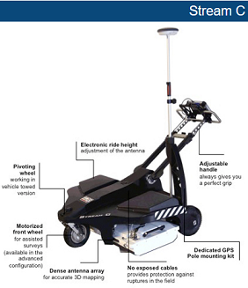
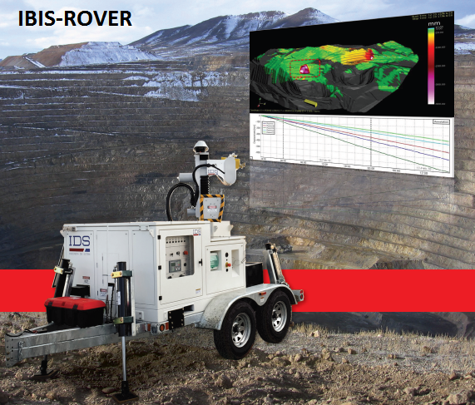
What is IDS GeoRadar?
The IDS GeoRadar Division is headquartered in Pisa, Italy, since being founded in 1980.
GeoRadar provides products and solutions for geophysical, civil engineering, and security applications.
IDS has became the largest global provider of GPR products.
Our IBIS TinSAR instrument was the first commercial ground-based interferometric radar with linear scan capabilities.
SUB-SURFACE Utility Mapping
Terrestrial Radar Monitoring
3

Slide 4

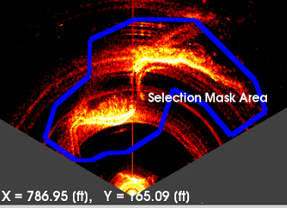
IBIS Acquisition Method
Resolution cell
IBIS Raw Data
IBIS-M
Sensor
Small antenna with a wide beam moved along a linear rail (2M) = high resolution.
Each resolution cell (pixel) is sampled continuously during a single acquisition. Scan time is less than 3 min. independently from the area to be covered
4

Slide 5
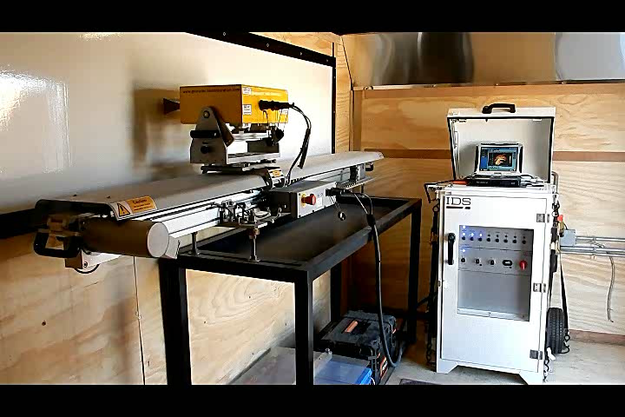
IBIS in Action
5

Slide 6
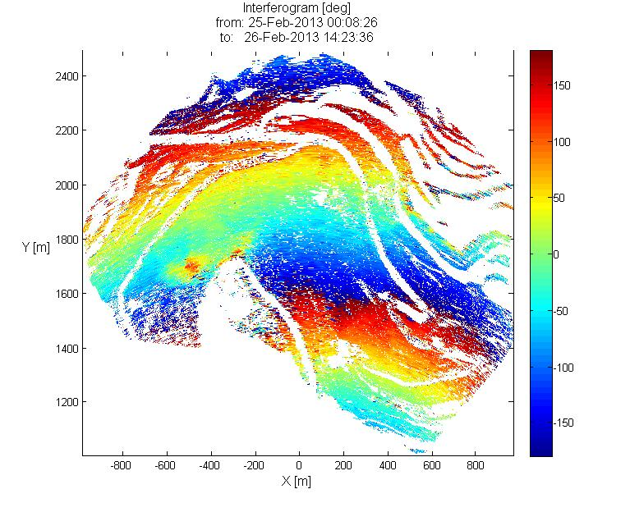
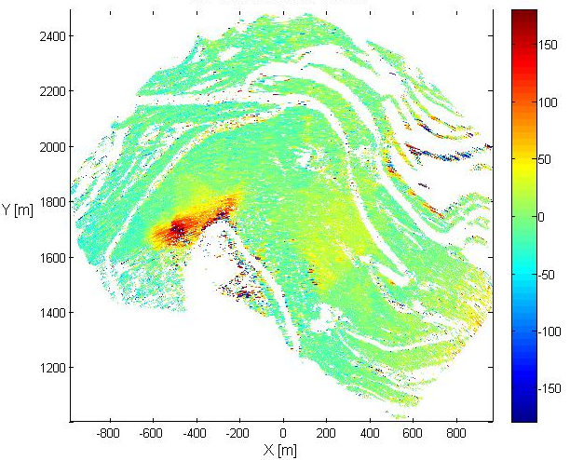
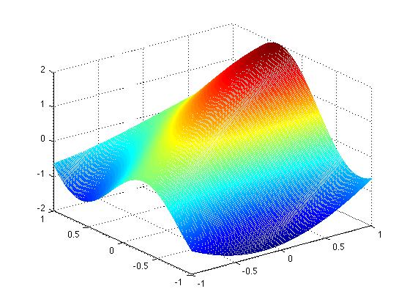
Serial Interferograms Processed with an Atmospheric Correction = Differential Data
6

Slide 7
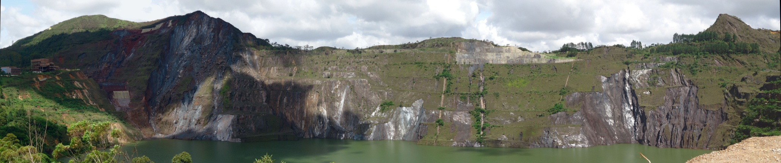
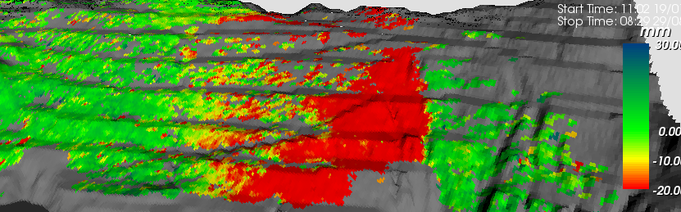
Early detection of new deformation, from the earliest stage until final-critical event
Subsampling-offline processing of 10 months of data
Average of 40 mm of cumulative displacement in 10 months
(0.1-0.2 mm/day)
7

Slide 8
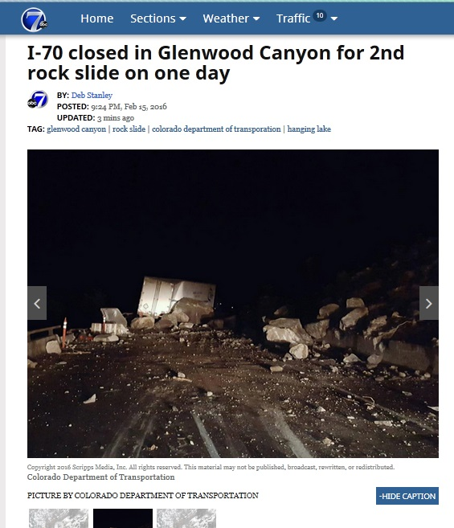
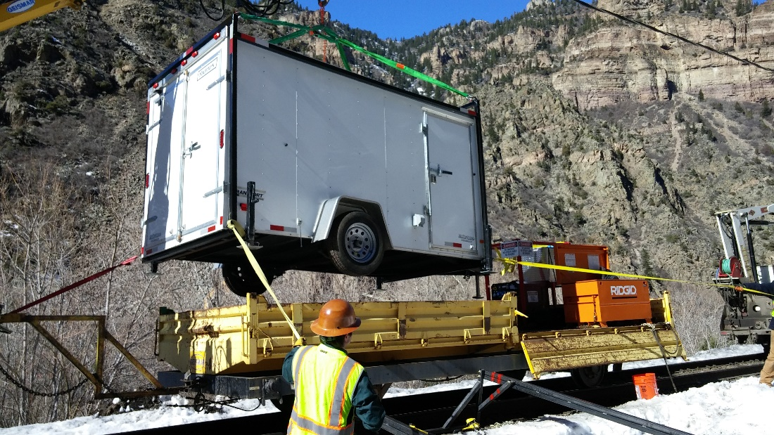
2016 DOT support: Event Response – E-mail + 12 hours = on-site for assessment
6-8 hours planning, initiate fab. custom trailer - complete install 96 hours from assessment.
8

Slide 9
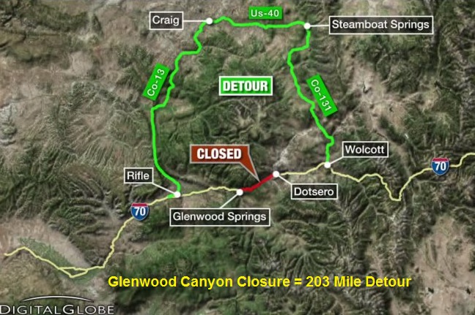
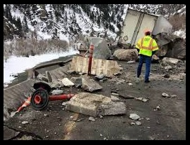
Data Analysis = Information for Decision Making Support
CDOT: The average daily traffic for Glenwood Canyon is around 300 vehicles per hour. In the summer season, that number can swell to around 500-600 vehicles per hour.
Detour costs are estimated at 1.3 to 1.6 million dollars a day in commercial losses.
9

Slide 10
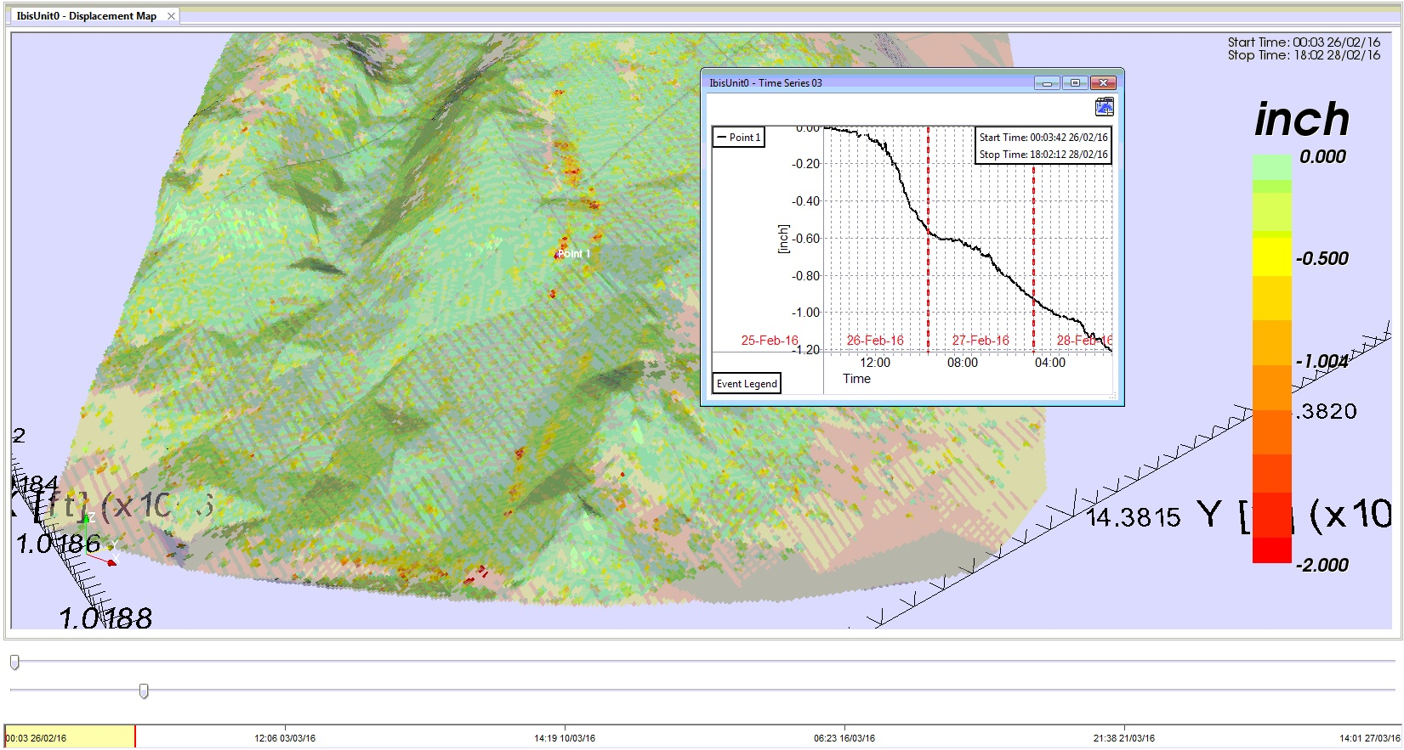
Reporting – Supported Live Decisions – To Re-open Traffic
Data: 3 days 1 “point” : range – 935’ cell size 3.28’
10

Slide 11
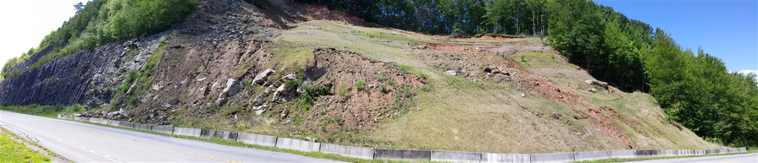
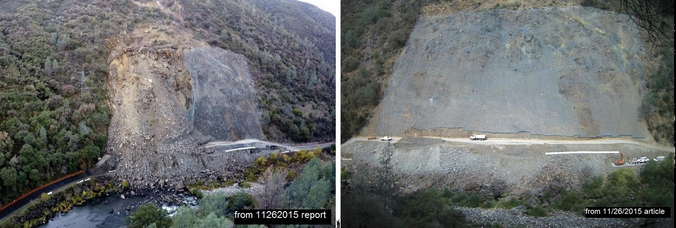
Weekly or Monthly – Geotechnical Asset Inquiry or Opportunity … endless supply…
NC- US64 near Franklin, North Carolina (8/2016)
CA Hwy 140 Ferguson Slide, near Yosemite N.P. (9/2016)
11

Slide 12
Ferguson Slide - Failed in 2006, monitored with radar for 3 months.
9 years of assessment, (USGS GPS Spiders) monitoring, analysis, engineering, contract process, bids, award, finally return to begin rockshed plan construction >$120 Million contract 8/2015
3 months in after work at the toe, and hanging mesh across the face 2nd slope failure
projected halted, in reassessment with core studies of base material and some type of displacement monitoring …awaiting report of viability of the project …community waiting for over 10 years…
How to focus reality (challenges) from field and sharing with colleagues (vendors, consultants, agencies).
Working discussions, considerations for spreading “Monitoring” ethic ..engaging education with business development …coming up with an “Option” we could communicate.
12

Slide 13
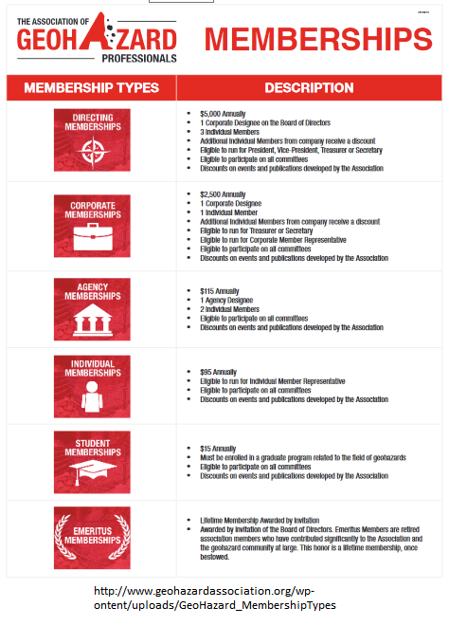
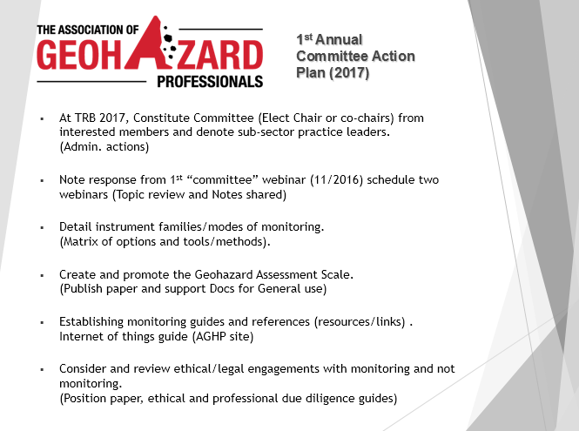
Current Efforts and Finding a Way Forward to a Greater Opportunity
At 67th HGS in Colorado, we submitted a proposal within the Association of Geohazard Professionals to create a new committee – Monitoring and Instrumentation.
13

Slide 14
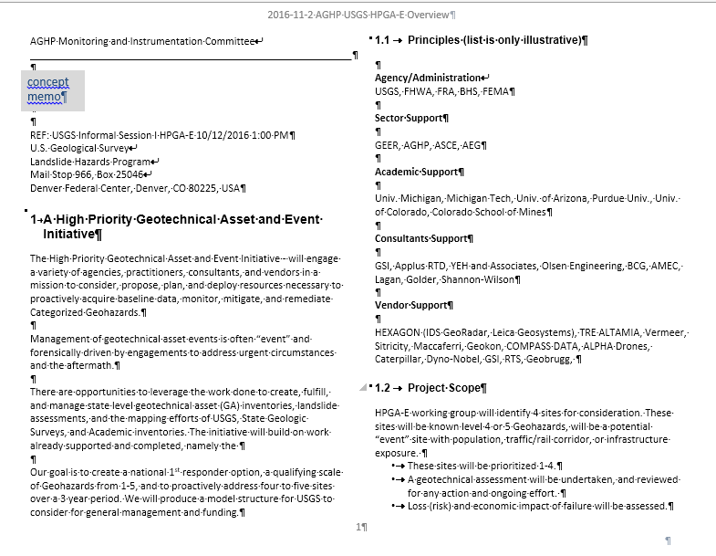
The High Priority Geotechnical Asset and Event Initiative HPGA-E
What is this?
Would anyone be interested?
“The USGS team was very interested in the forward looking assessment and proactive engagement aspects of the effort.”
14

Slide 15
Geotechnical Assets and Geohazards A National Responsibility? An Opportunity?
H. R. 4776
Introduced in House (03/17/2016) https://www.congress.gov/bill/114th-congress/house-bill/4776/text
To establish a national program to identify landslide hazards and reduce loss from landslides, and for other purposes.
“Congress finds the following:
…Landslides in the United States cause an estimated $3,000,000,000 in damage each year, and that estimation could be improved through better tracking of landslide occurrences and losses.
The most recent official estimate of deaths from landslides in the United States was in 1985, and it found that landslides kill an estimated 25 to 50 people each year.
On March 22, 2014, a massive landslide near Oso, Washington, killed 43 people, engulfed 42 homes, and severely damaged public infrastructure and private property.
There is no collective landslide inventory for most counties, States, or the United States, nor is there an agreed-upon methodology for creating one, since the availability of Light Detection and Ranging (LIDAR), a powerful tool for creating landslide inventories, is uneven and the quality is highly variable.
Because landslide hazard analysis continues to evolve, developing analysis methods is an important element of technical assistance for nongovernmental entities and State and local governments.
15

Slide 16
We are looking for allies and alignment partners.
Our expertise involves GPR and Terrestrial Radar monitoring project development, management and data analysis.
We are open to discussing joint and collaborative actions and initiative development….. Questions and Comments?
IDS Contact: john S. metzger – j.metzger@idscorporation.com IDS GPR contact – Alex Novo - a.novo@idscoporation.com
AGHP Contact – Becky Slaybaugh - bslaybaugh@geohazardassociation.org
16

